Slide 1
Predictive Model to determine life expectancy post surgery
By Shrushti Gangar, Palash Anjania, Krina Bhimani
Guide: Prof. Sindhu Nair

Slide 2
Introduction
In today’s modern world the death rate has been decreased significantly due to the technological advancement that has taken place. Surgeries have been made easy to perform and free of risk in many cases.
But there are certain surgeries which involve a high life risk post surgery, in such situations it is pertinent to predict the fitness of the patient post surgery.
Even after a lot of technological development, it is still difficult to predict whether the patient will have any complication post-surgery.
Any mis-production can pose a high danger to patients life. Thus it is very important to make sure that there are as less miss-predictions as possible in order to ensure that we are aware of the upcoming danger if any.
We aim on developing a model to predict these probable life threatening situation within a year of the surgery.

Slide 3
Problem Definition
Being a doctor is not easy, especially in India. There are hundreds of surgeries happening everyday. Keeping track of these patients after the surgery is a difficult task.
Usually a period of 30 days is considered to see whether the patient develops any issue or complication but those 30 days are not enough time.
Hence, an automated model with the following features and capabilities is needed.
Store the patients’ data.
Select features relevant to make a decision.
Predict the probability whether the patient will live post a year of surgery.

Slide 4
Scope
It is always very handy to know the risk involved after the operation is completed. When it is possible to predict the life expectancy post a year of the surgery, it eases the doctor’s work to give prescription. Moreover the patient and its family is intimated of the risk involved.
These days cancer is one of the major causes of death in most countries.Currently, lung cancer is the most frequent cause for thoracic surgery. Postoperative respiratory complications can prove to be fatal, following any type of thoracic surgery.
This project aims at using the machine learning algorithms for discovery and identify models and relationships between them, from large datasets, the data is analysed to extract useful information that supports life expectation augury, and to develop models that predict patient’s health more accurately.

Slide 5
Literature survey
Adam Abdulhamid, Ivaylo Bahtchevanov and Peng Jia[1] in their paper titled “Life Expectancy Post Thoracic Surgery” adopted various supervised machine learning techniques including Naive Bayes, SVM, and Logistic Regression in order to train the dataset and obtain testing values using k-folds cross-validation considering k equals to 10. In their research, they later applied the bootstrapping method on randomly sampled data in order to obtain a split in the dataset. Later, they trained 40 models and obtained 40 different predictions and then the average of them was taken in order to get the final prediction. Finally, datasets of different sizes were tried and tested in order to check its effect on accuracy and recall.
Abeer S. Desuky and Lamiaa M. El Bakrawy [2] in their paper titled “Improved Prediction of Post-operative Life Expectancy after Thoracic Surgery ” have used three attribute ranking methods to reduce the number of attributes such as Symmetrical Uncertainty(SU), Information Gain(IG), Relief Factor(RF) and examined the quality of Machine learning algorithms like Naive Bayes, Simple Logistic, Multilayer Perceptron and J48 by comparing their performance with or without attribute ranking methods along with the boosted versions of the machine learning algorithms. The researchers have used ten-fold cross-validation technique to validate the results. Ten rounds of cross-validation is performed and in each round 2 through 10 used as testing dataset. The validation dataset is averaged over the ten rounds in the final phase.

Slide 6
Literature survey
Kwetise Joro Danjuma [3] has adopted a different technique Synthetic Minority Over-Sampling Technique (SMOTE) in the research paper titled “Performance Evaluation of Machine Learning Algorithms in Post-Operative Life Expectancy in the Lung Cancer Patients ” to generate synthetic minority samples to oversample the minority class and smoothen the sample distribution. It operates by interpolating between several minority class examples that lie together, using the concept of k-nearest neighbour to avoid overfitting causing the decision boundaries for the minority class to spread further into the majority class space. In this research paper, the thoracic datasets is dedicated to classification problem related to the post-operative life expectancy in lung cancer patients : class1 - death within one year after surgery, class 2 - survival; recoded as Risk1Y: 1 year survival period -(T)rue value if died (T,F), where the class is (Risk1Y) is binary-valued. Multilayer Perceptron, J48 and Naive Bayes machine learning algorithms were calibrated to optimize the baseline performance accuracy of each classifier.

Slide 7
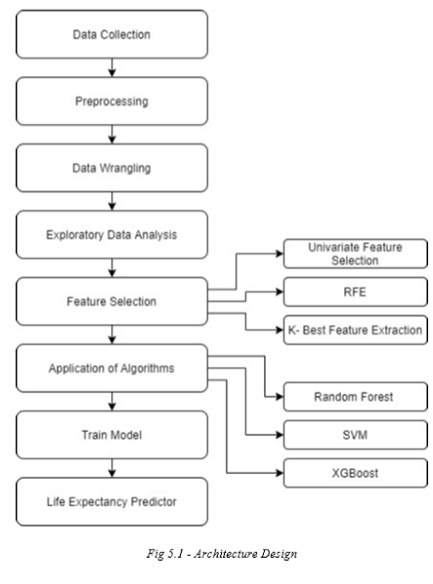
Architectural Design
The architecture flows like any other machine learning project.
The difference is the use of various techniques of feature selection and classification algorithm makes the output precise and clear.
To the untrained eye it seems confusing but it is a very simple process.

Slide 8
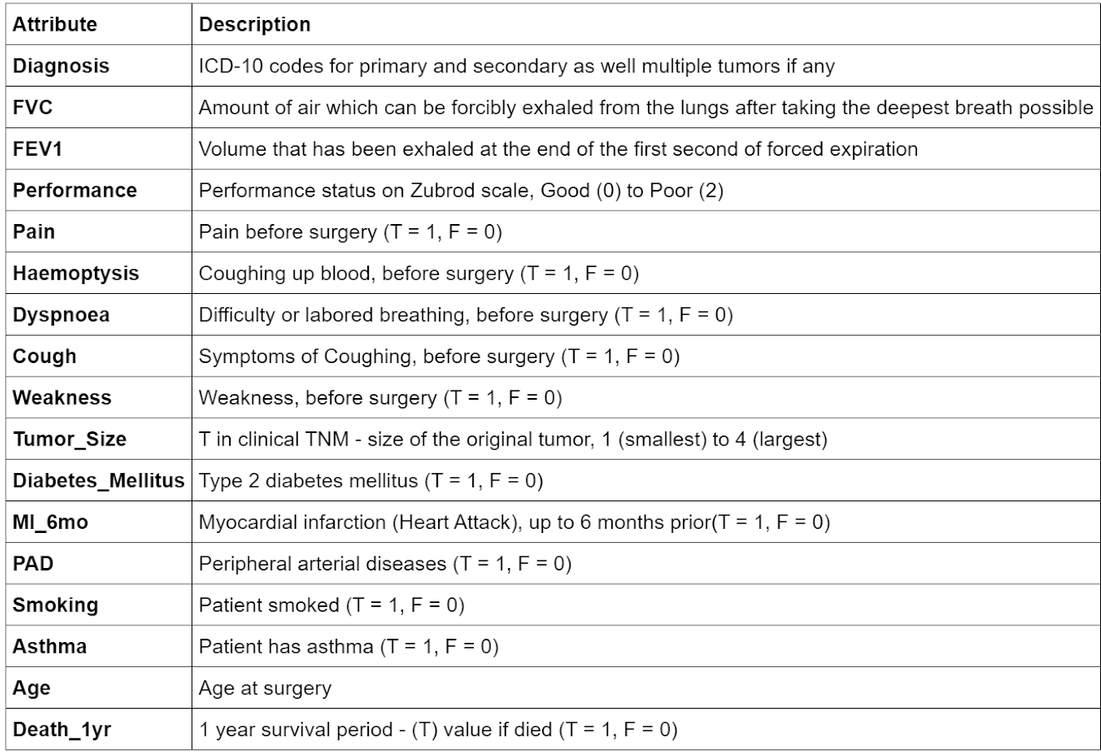
Dataset

Slide 9
Implementation Steps
Data Pre-processing
Initially, the dataset from the respective repository was WEKA ARFF format, so the first step was to convert in CSV format. There were no missing values or NaN values present in the dataset. For numerical columns, we need to consider outliers and thus plot scatter plots.
Data Wrangling
By observation, there are 11 columns namely PRE7, PRE8, PRE9, PRE10, PRE11,PRE17, PRE19, PRE25, PRE30, PRE32 and Risk1Yr in the dataset that has boolean values T or F. So convert these values into 1 and 0 respectively. As there are columns name Performance, tumor_size and diagnosis which has numerical value attached to string. So here only considered numeric value for easy evaluation. Further age was converted into specific range like 0-20, 21-40, 41-60, 61-80 and 80 above.

Slide 10
Implementation Steps
EDA
Out of the 1270 patients, 203 died and 1067 lived the 1 year period after surgery. So, 16.0% of patients died.
Several features presented strongly for those who died: Dyspnoea, Diabetes Mellitus, Pain, PAD, and Haemoptysis (Top 5 in decreasing order).
Overall, most patients who received surgery smoked (~80%) and presented with symptoms of coughing (~70%), while the rest of the attributes presented under 20% of the total patients.
Majority of patients were categorized as diagnosis code 3. The proportion of live to dead is similar for the diagnosis codes. For tumor size, most of the patients are in category 1 and 2, and the data presents a trend of more proportion of dead as tumor size increases. For performance, the trend observed is more proportion of dead as performance zubrod score increases, which means patient performance decreases.
The next few slides display graphs and charts from the analysis

Slide 11
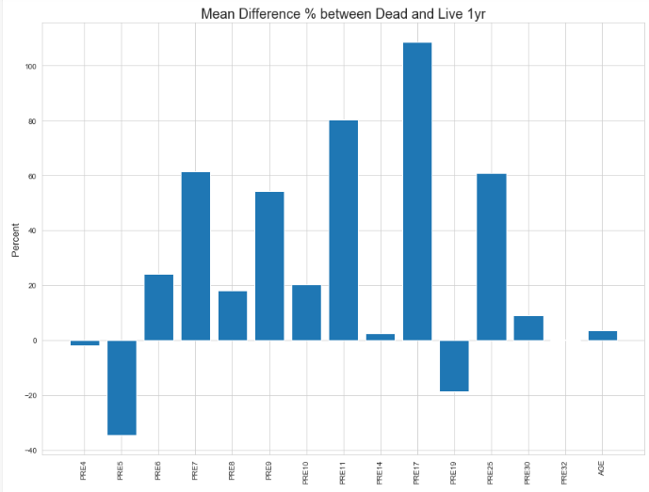
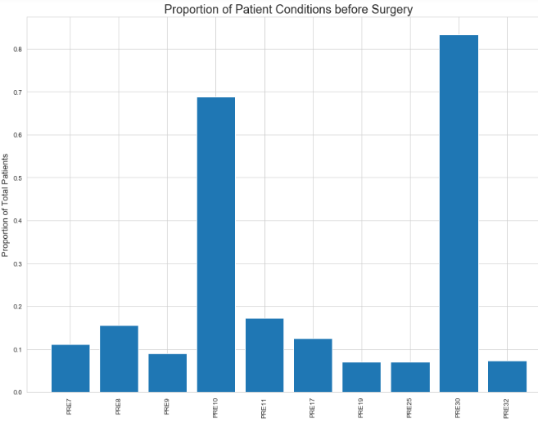

Slide 12
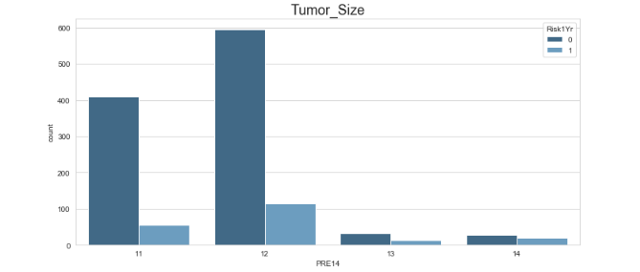
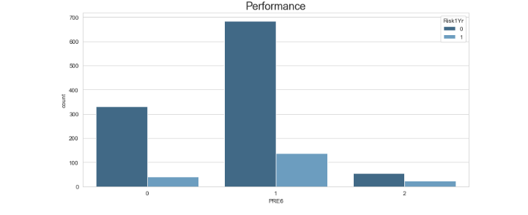
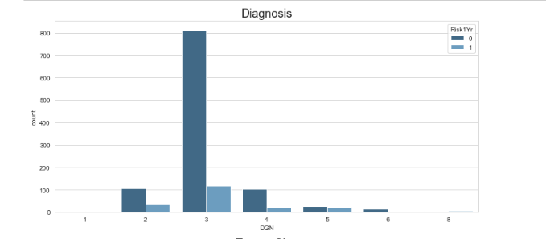

Slide 13
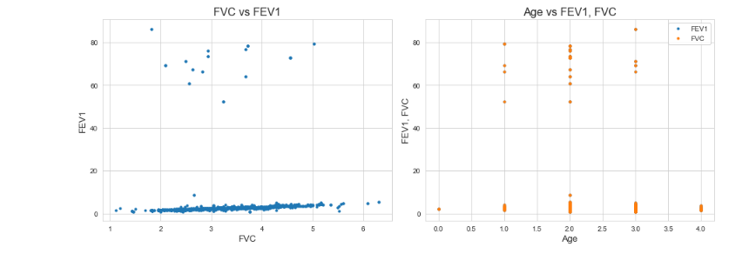
Hypothesis testing reveals attributes of significance: Performance, Dyspnoea, Cough, Tumor_Size, Diabetes_Mellitus.

Slide 14
Results of Hypothesis Testing
Attributes | Value
FVC | 0.1632
FEV1 | 0.0192
Performance | 0.0001
Pain | 0.0106
Haemoptysis | 0.1902
Dyspnoea | 0.0286
Cough | 0.0002
Weakness | 0.00002
Tumour_Size | 0.00004
Diabetes_Mellitus | 0.00008
MI_6mo | 0.412
Peripheral Artery Disease | 0.0403
Smoking | 0.0041
Asthma | 0.5487
Age | 0.023

Slide 15
Why Feature Selection ?
Feature Selection is the process where you automatically or manually select those features which contribute most to your prediction variable or output.
Irrelevant features in the data can decrease the accuracy of the models and make your model learn based on irrelevant features.
Benefits of performing feature selection before modeling your data:
Reduces Overfitting: Less redundant data means less opportunity to make decisions based on noise.
Improves Accuracy: Less misleading data means modeling accuracy improves.
Reduces Training Time: fewer data points reduce algorithm complexity and algorithms train faster.

Slide 16
Feature Selection Method Used
Recursive Feature Elimination
The Recursive Feature Elimination (or RFE) works by recursively removing attributes and building a model on those attributes that remain.It uses the model accuracy to identify which attributes (and combination of attributes) contribute the most to predicting the target attribute.
Univariate Feature Selection
Univariate feature selection works by selecting the best features based on univariate statistical tests. We compare each feature to the target variable, to see whether there is any statistically significant relationship between them.
Select K Best Feature
Feature selection using SelectKBest. Feature selection is a technique where we choose those features in our data that contribute most to the target variable. In other words we choose the best predictors for the target variable.

Slide 17
Algorithms used
These are the algorithms that we used in our final year project
Extreme Gradient boosting (XGB) - Ensemble Technique
XGBoost is one of the implementations of Gradient Boosting concept, but what makes XGBoost unique is that it uses “a more regularized model formalization to control over-fitting, which gives it better performance”.
SVM - Machine Learning Algorithm
The objective of the support vector machine algorithm is to find a hyperplane in N-dimensional space(N — the number of features) that distinctly classifies the data points. To separate the two classes of data points, there are many possible hyperplanes that could be chosen.
Random Forest Algorithm
Random forests or random decision forests are an ensemble learning method for classification, regression and other tasks that operate by constructing a multitude of decision trees at training time and outputting the class that is the mode of the classes (classification) or mean prediction (regression) of the individual trees.

Slide 18
Implementation Steps
So now that we have thoroughly examined the patterns and trends in the data set, the next step is to use machine learning models to see if the target variable, Death 1yr, with the function variables can be predicted as well.
Because the data set is imbalanced and mostly live patients (84%), only predicting all live patients would yield a high precision score of ~84%.
So for the model, accuracy is not a reasonable method of score and instead looks at the confusion matrix. Before proceeding for modelling, not every attribute of the dataset contributes towards the result. So in order to evaluate which attributes affect the result, we performed feature extraction.
All the feature extraction by default provides with half attributes of the total. So considering EDA, we considered 10 attributes for modelling.
First step was to split the dataset into training and test data where 30 percent is test data using sklearn functions. Once this is done, feature scaling is done for standardization purposes. Starting with the first model Support Vector Machine, with the help of sklearn we imported an SVM classifier which helps to train and fit the dataset and further helps to predict the accuracy and confusion matrix. Further same procedure was followed for Random forest and Xgboost.

Slide 19
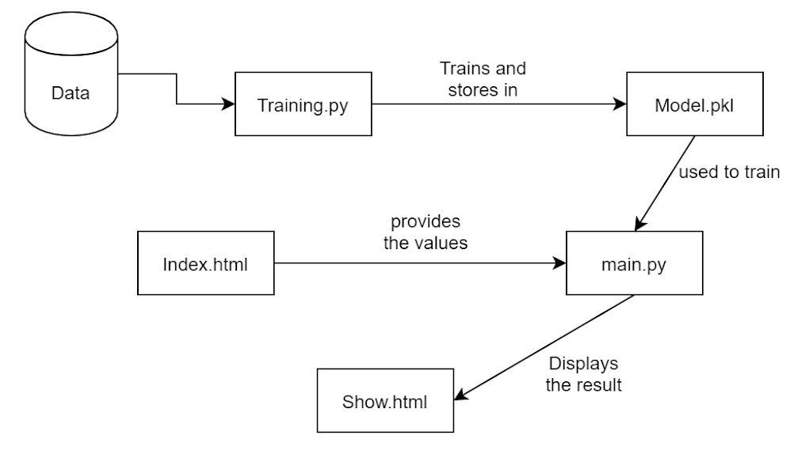
Steps / Working of the project GUI
The project consists of a Machine Learning model which is trained over the dataset to predict the probability of patients.
The dataset is used by the training.py to train and test the model. This trained model is then stored in a file called model.pkl. This model.pkl is stored remotely and called by the main.py to predict the output.
The trained model gets inputs required for prediction from the index.html file which is entered by the user. These inputs are used by main.py to predict the probability of survival. This prediction is displayed in show.html file

Slide 20
Result Analysis
a. Recursive Feature extraction
The recursive feature extraction selected 10 top features that will make the model better and avoid overfitting. The selected features are FVC, Performance, Haemoptysis, Dyspnoea, Cough, Tumor_Size, Myocardial infarction, Smoking, Asthma and Age.
b. Univariate Feature extraction
The recursive feature extraction selected 10 top features that will make the model better and avoid overfitting. The selected features are FVC, FEV 1, Performance, Pain, Weakness, Cough, Tumor_Size, Myocardial infarction, Smoking and Asthma.
c. Select K best Feature extraction
The select K best selected 10 top features that will make the model better and avoid overfitting.
The selected features are Diagnosis, Performance, Pain, Cough, Weakness, Tumour size,
diabetes mellitus and smoking.

Slide 21
Result Analysis
Support Vector Machine
We applied the SVM algorithm on the output of all the feature extraction. Out of those the best accuracy was obtained in RFE. The SVM algorithm on classification of the data from RFE gave an accuracy of 85.56%. This is a good accuracy but it could be further improved. To improve the accuracy we used Random Forest algorithm.
2. Random Forest
We applied the Random Forest algorithm on the output of all the feature extraction. Out of those the best accuracy was obtained in RFE. The Random Forest algorithm on classification of the data from RFE gave an accuracy of 89.07%. This is a good accuracy but it could be further improved. To improve the accuracy we used Extreme Boosting algorithm.
3. Extreme Boosting
We applied the Extreme Boosting (xgb) algorithm on the output of all the feature extraction. Out of those the best accuracy was obtained in RFE. The xgb algorithm on classification of the data from RFE gave an accuracy of 91.07%. This is only 1% increase in the accuracy but it makes a load of difference in the prediction capabilities. The xgb algorithm boosts the model to make clear and accurate prediction.

Slide 22
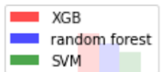
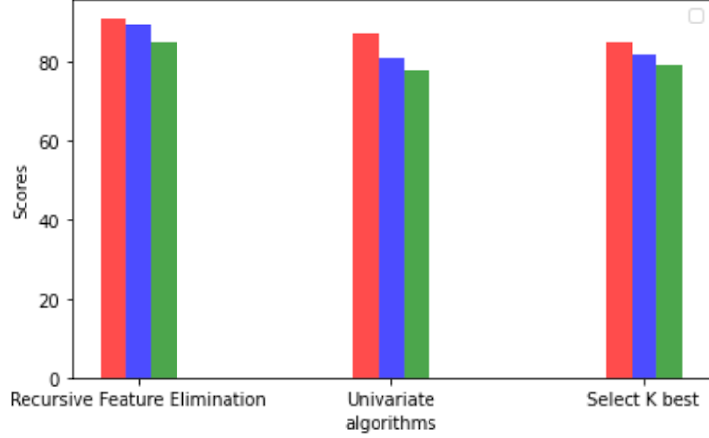
Accuracy of Algorithms

Slide 23
Conclusion
The main aim of the model is to ease the decision-making process of whether the patient will have any post-surgery complications.
As opposed to the currently used 30-day mortality rate, our solution aims to expand this time period to up to a year thus increasing the effectiveness.
The model proposed in this project serves the purpose of selecting appropriate features using the recursive feature elimination method and then apply machine learning algorithms like SVM and ensemble technique like XGB (Extreme Gradient Boosting) in order to approximately predict the survival rate of a patient after a year post-surgery.
This model is machine learning model specifically designed for thoracic surgery and fulfils its purpose with good results.
The project successfully predicts the survival rate of the patient using Extreme Boosting algorithm with an accuracy of 91.07%.

Slide 24

Future Scope
The project predicts whether the patient has survived for a year or not and hence this project has many applications for the future.
The project primarily focuses on thoracic surgery, but it can be applied to various other surgeries and medical practices.
The model’s accuracy could be increased by bumping or boosting methods to produce reliable results.
Also the models could be applied without ranking or feature selection with good accuracy and recall.
We can also apply other feature selection and data mining techniques and obtain much better accuracy with reduced number of features.
Bootstrapping could be another useful method to apply for improving the results.

Slide 25
References
[1] Adam Abdul Hamid, Ivaylo Bahtchevanov, Peng Jia, “Life Expectancy Post Thoracic Surgery”, Stanford University - CS 229
[2] Abeer S. Desuky and Lamiaa M. El Bakrawy, “Improved
Prediction of Post-operative Life Expectancy after Thoracic Surgery”, Al-Azhar University, Cairo, Egypt.
[3] Kwetise Joro Danjuma, “Performance Evaluation of Machine Learning Algorithms in Post-Operative Life Expectancy in the Lung
Cancer Patients ”, Department of Computer Science, Modibbo Adama
University of Technology, Yola, Adamawa State, Nigeria.
[4]https://www.analyticsvidhya.com/blog/2017/09/understaing-support-vector-machine-example-code/
[5]https://towardsdatascience.com/support-vector-machine-introduction-to-machine-learning-algorithms-934a444fca47
[6]https://blog.exploratory.io/introduction-to-extreme-gradient-boosting-in-exploratory-7bbec554ac7
[7]https://machinelearningmastery.com/gentle-introduction-xgboost-applied-machine-learning/
[8]https://towardsdatascience.com/feature-selection-in-python-recursive-feature-elimination-19f1c39b8d15
[9]https://www.scikit-yb.org/en/latest/api/model_selection/rfecv.html
[10]https://towardsdatascience.com/feature-selection-using-python-for-classification-problem-b5f00a1c7028

Slide 26
Thankyou
- By Shrushti Gangar, Palash Anjania, Krina Bhimani

